Slide 1



Mrinal Rai Vidushi Garg Riteeka Ratnakar
Aashay Tiwari

Slide 2

Existing Application
The applications currently available for Event Management do not provide the ease of creating the event and organising it as per their demand.
VenYou provides its customers personalized, exclusive event experience
We provide completely integrated solution, quick and easy ways to embed event checkout
VenYou allows you to take control of your brand and own the entire customer brand experience

Slide 3

Want to organise your event?
VenYou provides unique solution to customers who want to coordinate their events in their own ways.
They can set a theme to their events
They can contact the vendors personally and make the event happening as per their taste
The app takes care of everything right from contacting vendors to ticket sale, so the organiser can just sit at home and enjoy their day while we handle the whole workload for them.

Slide 4

Want to join an event?
VenYou is a unified platform where you can find everything about the latest events happening in your city.
You can sort the events based on time or type of event
You can add filters to make your search quick and easy
The user can create groups of people who they want to invite and invite a whole bunch of people at the ease of a button
The users can also share pictures and videos of the events and checkout the same uploaded by other attendees
We have also provided the ease of commute and payment by integrating other applications like google maps, uber and payment gateways in our application.

Slide 5

PROBLEMS FACED
Single platform not available for all needs
No freedom to organize event at user’s will
Paper wasted on ticket printouts
Cashless transactions not available for all events

Slide 6

SOLUTIONS PROVIDED
Everything is online
Cashless transactions
No paper wasted
Just use your phone and get your event organized

Slide 7


Slide 8

Business Objectives
Allow users to host a business or personal event
Allow users to find, share and attend events
Allow users to register a spot in the event and make payments
Allow users to provide feedback and recommendations for a particular event
Allow users to filter currently happening events around them and how to join them

Slide 9
User Needs
Host a business or personal event
Find, share and attend events
Register a spot in the event and make payments
Provide feedback and recommendations for a particular event
Filter currently happening events around them and how to join them

Slide 10
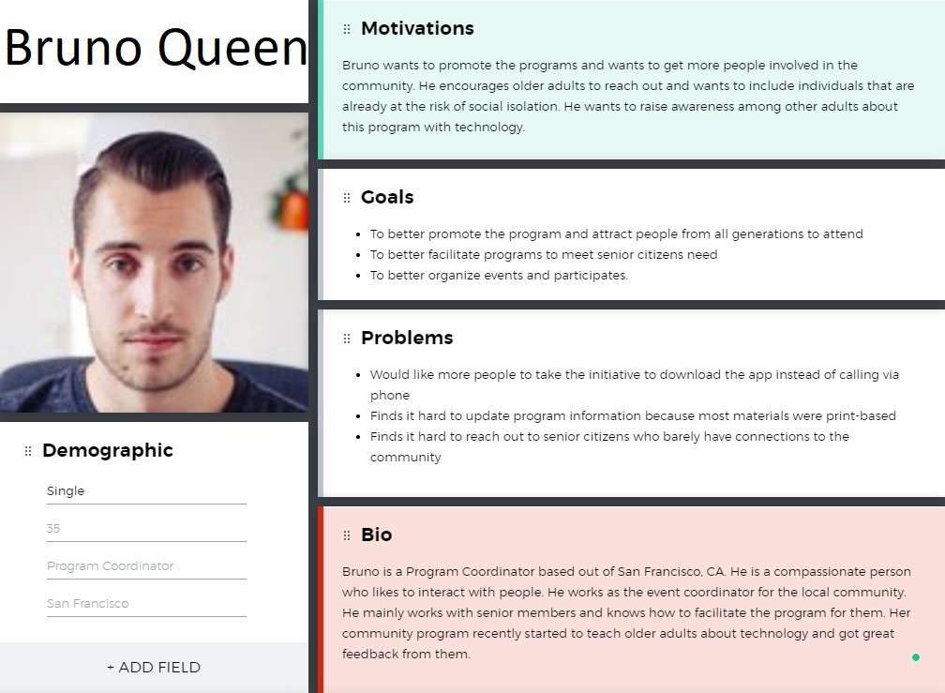

Slide 11
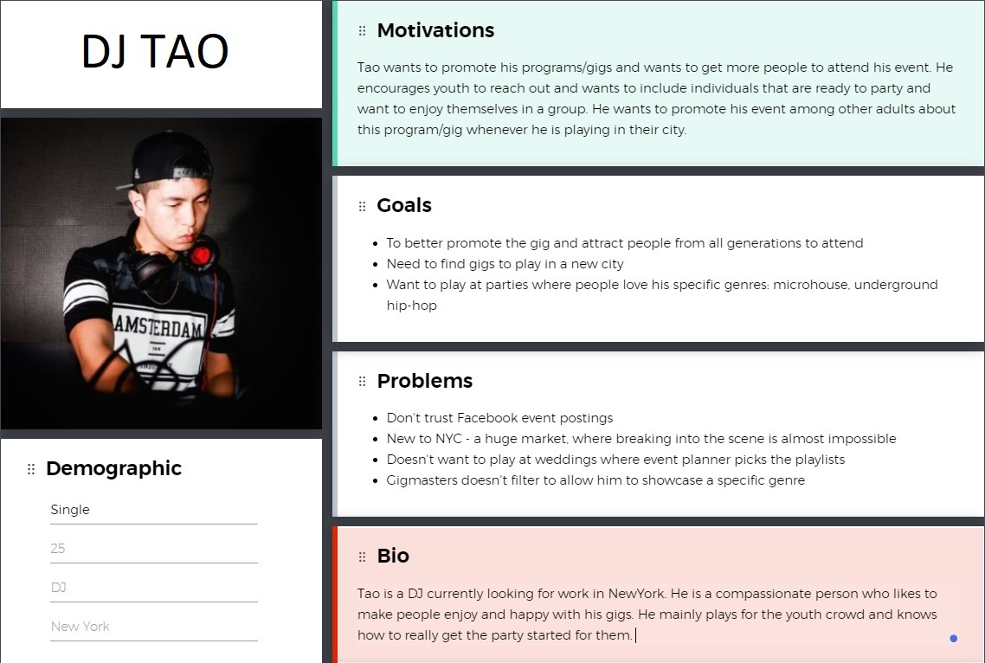

Slide 12
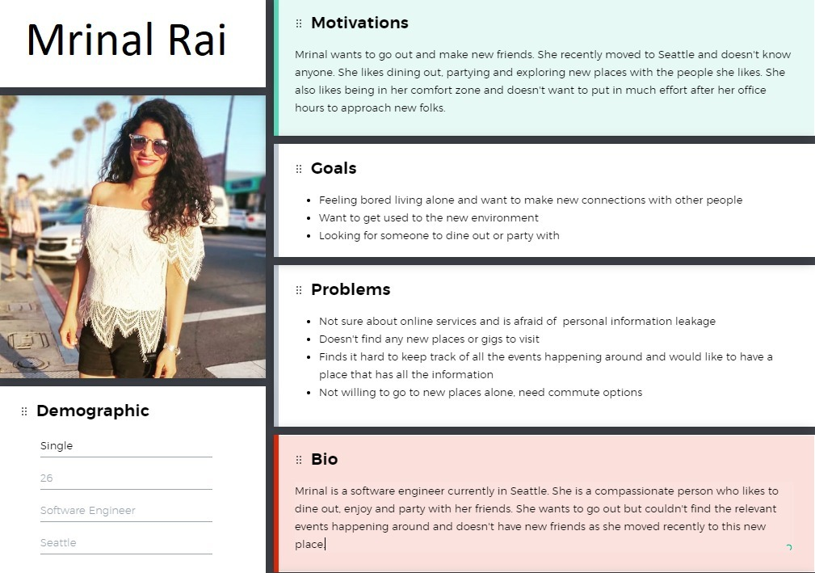

Slide 13

SCOPE PLANE

Slide 14

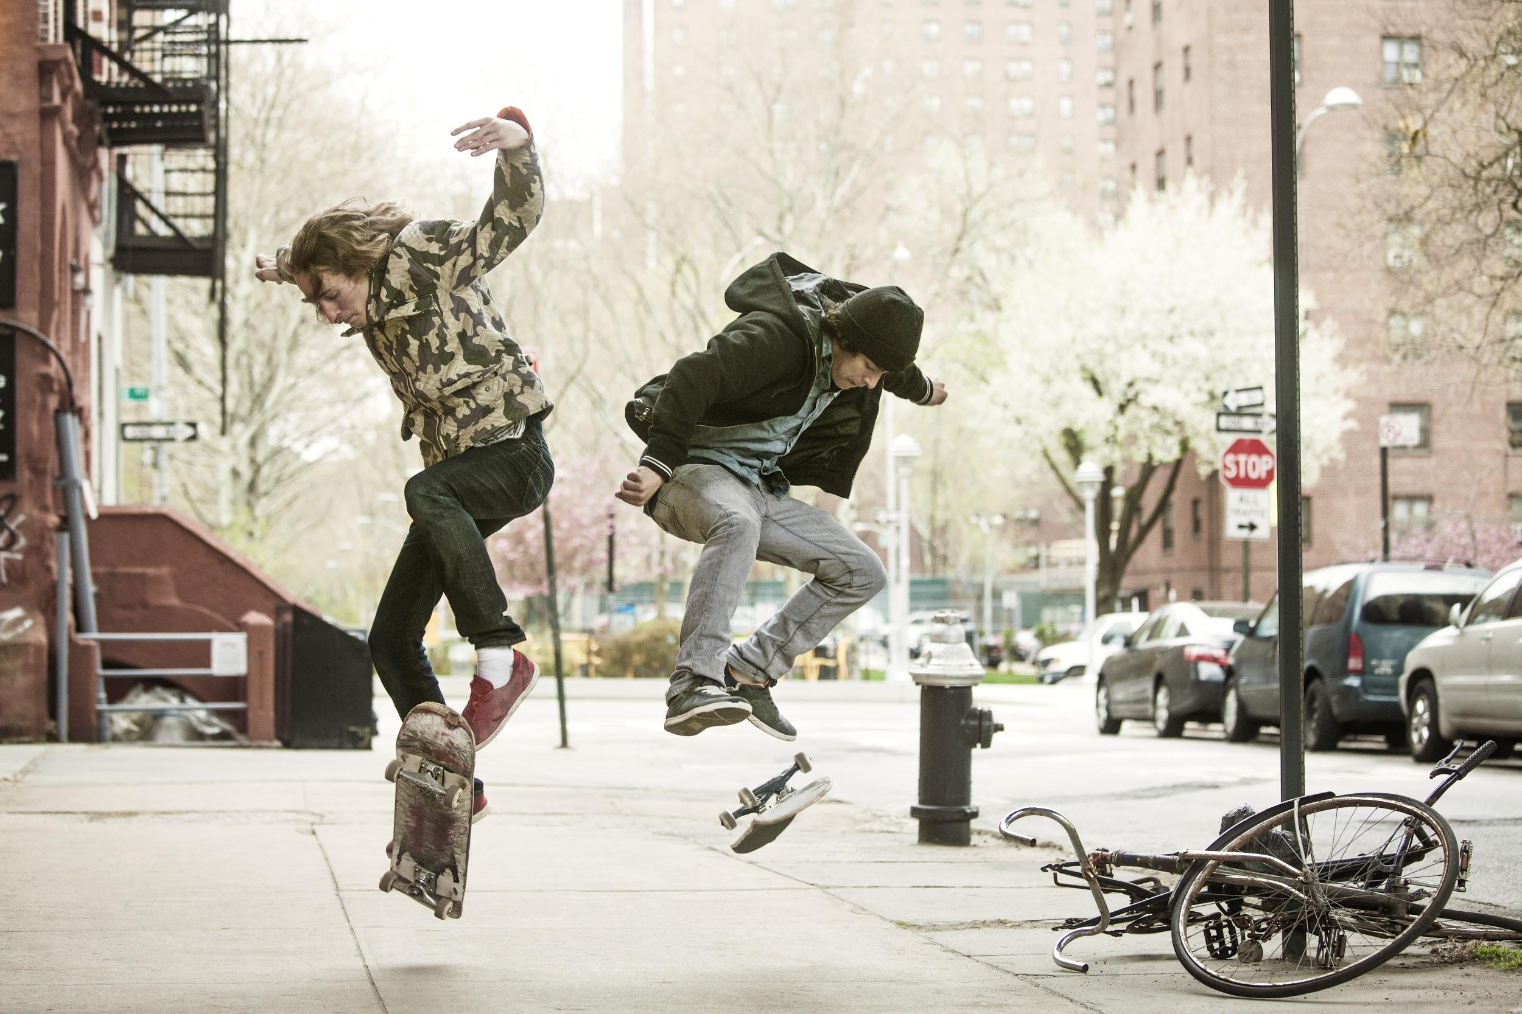
FUNCTIONAL REQUIREMENTS
Application should allow the user to create and host an event using their own login id
Application should have specific map and location of an event
The application must be integrated with other service apps like commute, payment solutions , etc
The application must have a feature for the user to add list of friends/ family members to be invited
The app suggests various vendors for all the required services such as caterers, music bands/ artists
The application must have picture and video upload feature

Slide 15
CONTENT REQUIREMENTS
Logged in users can see the uploaded picture having quality as per their phone’s specification
The user must have location on in order to use the interactive feature of the application
The live news feed feature must be as per user’s timezone
User must be able to add a profile picture on their account
The profile picture must appear round and will be cropped from what has been uploaded by the user

Slide 16
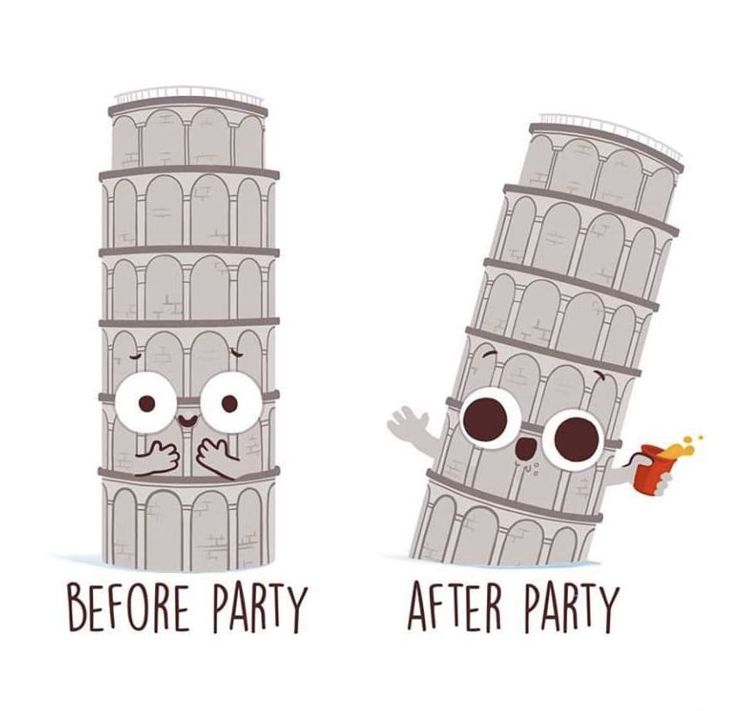
STRUCTURE PLANE

Slide 17

CONCEPTUAL MODEL
Users’ impressions of how the interactive components we create
will behave are known as conceptual models.
The whole application behaves consistently
The home button is signified by the home icon and the logo as well
The user can navigate back to a few screens from anywhere as they have been provided in the nav bar for the ease of user
The heart icon is used to signify the events liked or marked as favorite by the user

Slide 18
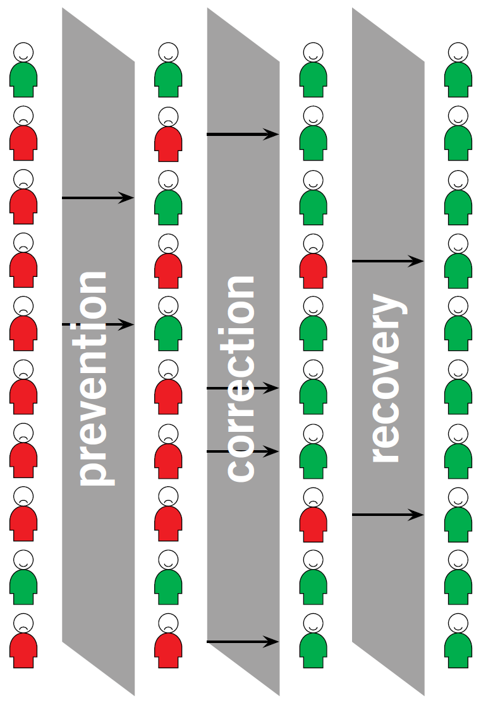
ERROR HANDLING
Error handling involves dealing with user error—what does the system do when people make mistakes, and what can the system do to prevent those mistakes from happening in the first place?
We have provided user known icons so that the whole UI looks familiar and avoids error from user part
If the user makes an error while browsing through the UI, we have provided a live chat option where the user can directly talk with an expert
In order to recover from an error made by the user we have provided a contact us option so that the user can feel free to sek help

Slide 19
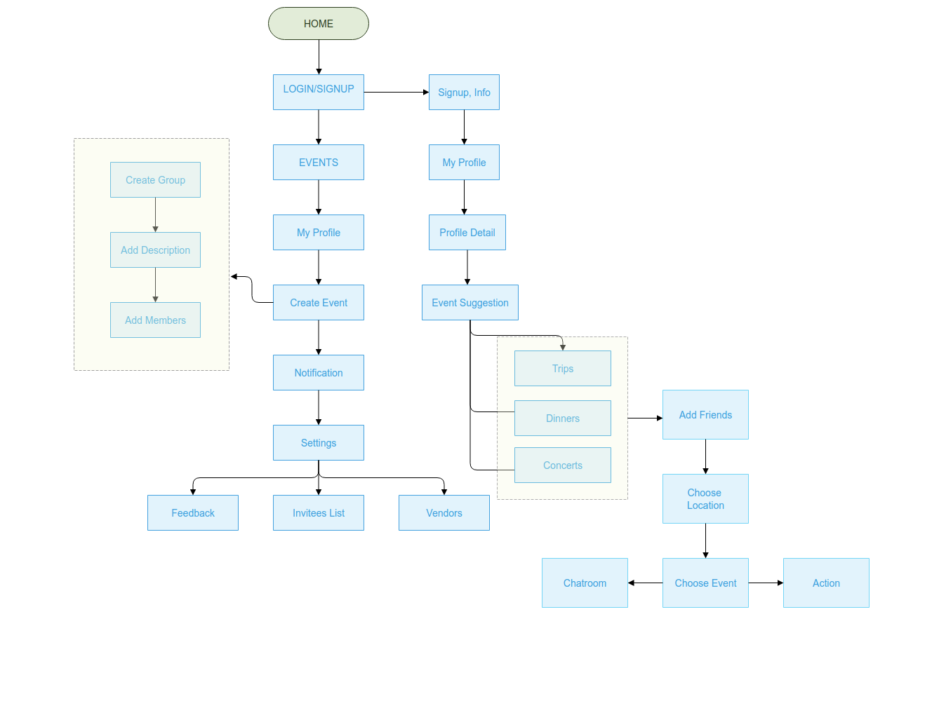

Slide 20

WIREFRAMES
Mockup link of VenYou: https://app.moqups.com/BTSOAbCflM/edit/page/a6b98f658

Slide 21
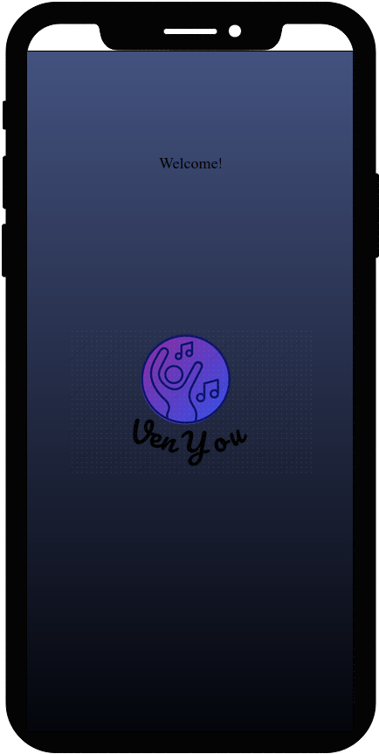
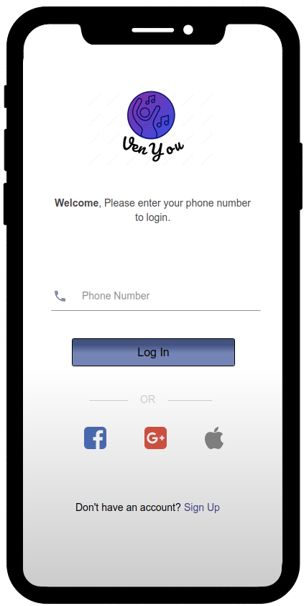
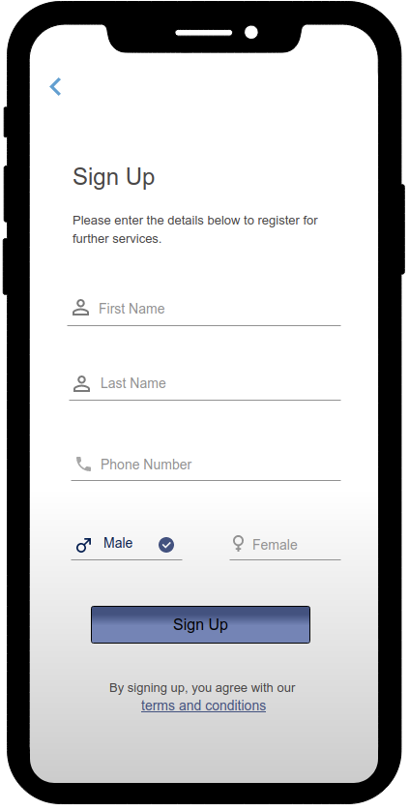

Slide 22
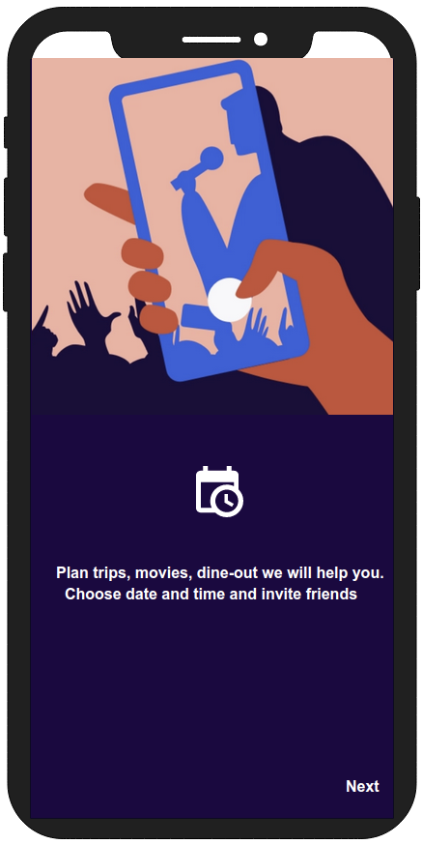
ONBOARDING

Slide 23
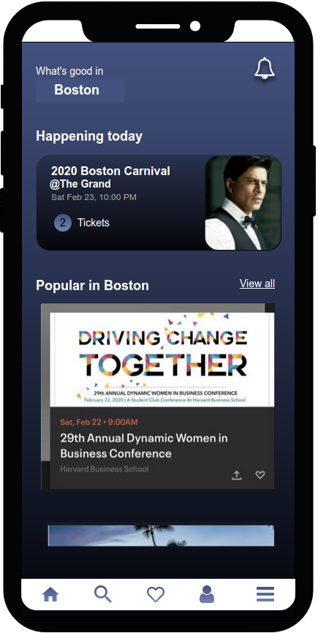
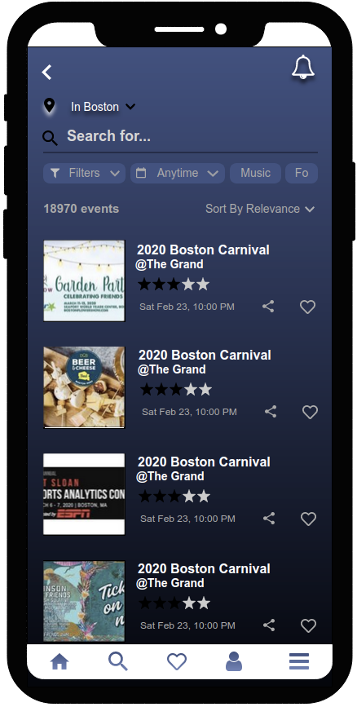

Slide 24
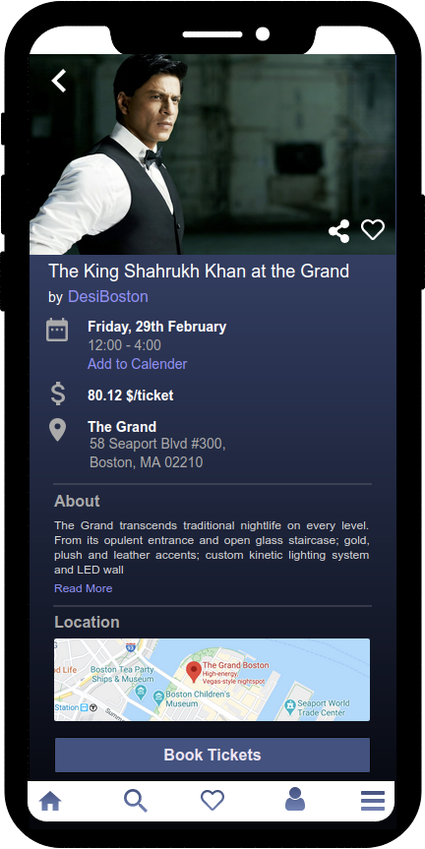
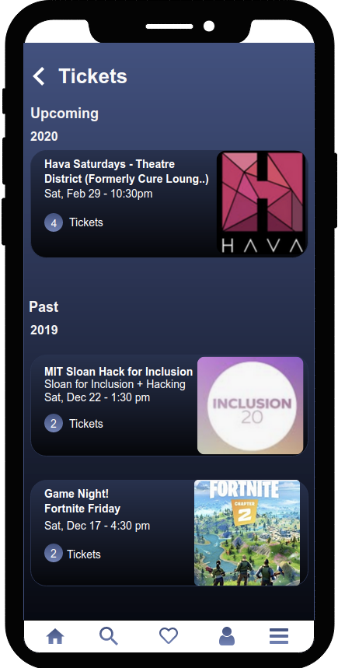

Slide 25
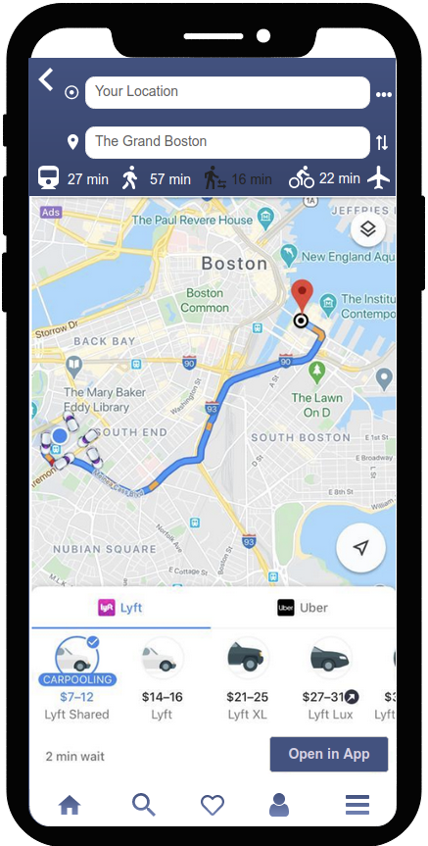
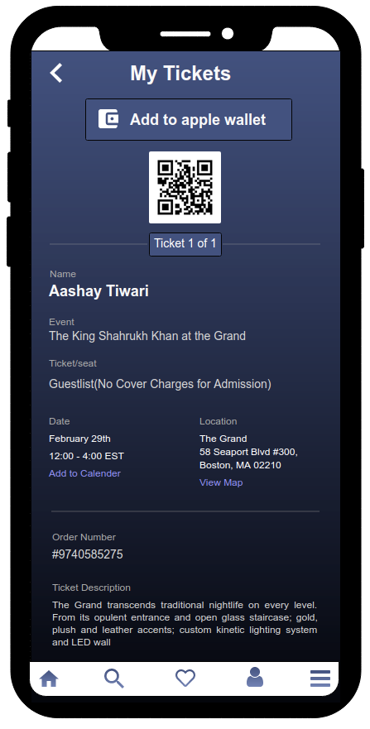
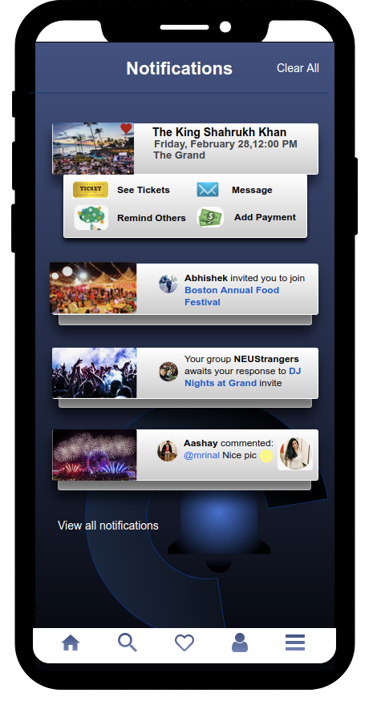

Slide 26
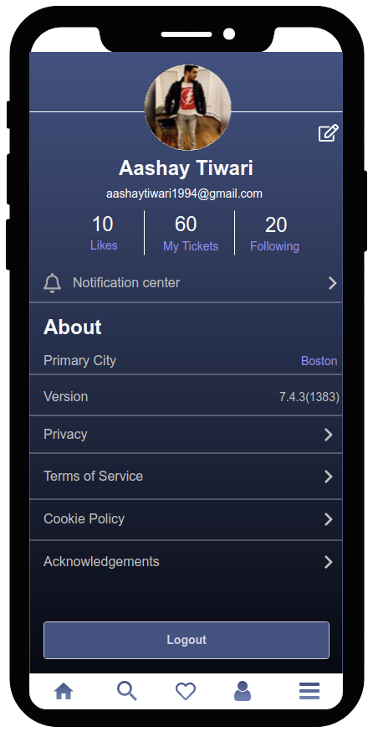
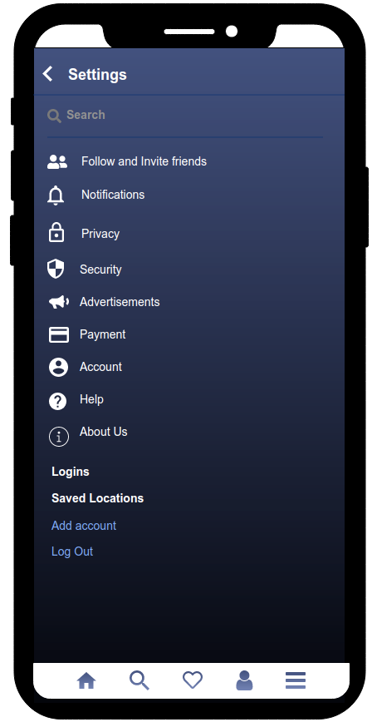
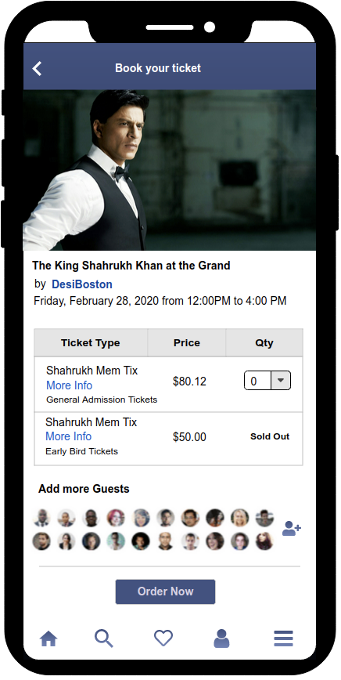

Slide 27

USER REQUIREMENTS

Slide 28
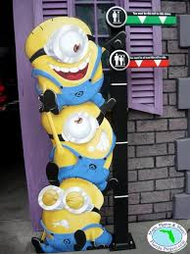
BASIC REQUIREMENTS
• Sort and filter
• Interactive maps/ location
• Live news feed of event
• Reminder through app notification
• Provide commute options to venue
• Adding list of invitees to the event
• Appointment scheduling with service providers
• Featured event highlights
• Picture uploads by use
• Feedbacks and rating

Slide 29

TECHNICAL REQUIREMENTS
· Database to store user details
· Login and registration page
· APIs for data transfer
· Mapping of front end with the backend
· Security
· Information management
· Software platform

Slide 30
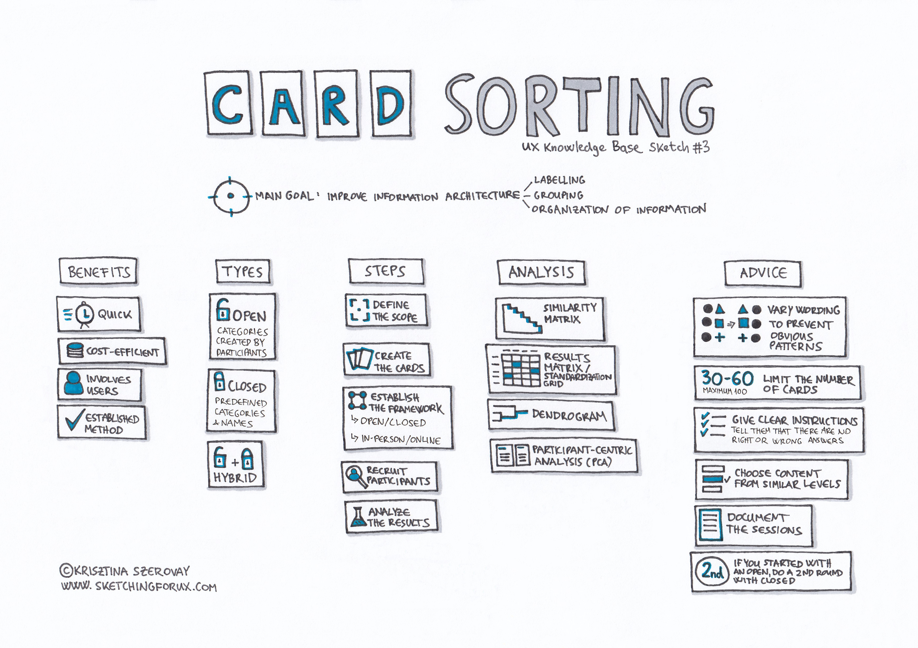

Slide 31

CARD SORTING
We applied card sorting technique to identify what users are expecting and want us to have in the App
It is used to develop the better and more user centric Information Architecture
We asked around 50 people in groups of 10 to take part in this usability testing method
Our cards consisted mainly of categorized items and scope of the application

Slide 32

LEARNINGS FROM LECTURE

Slide 33
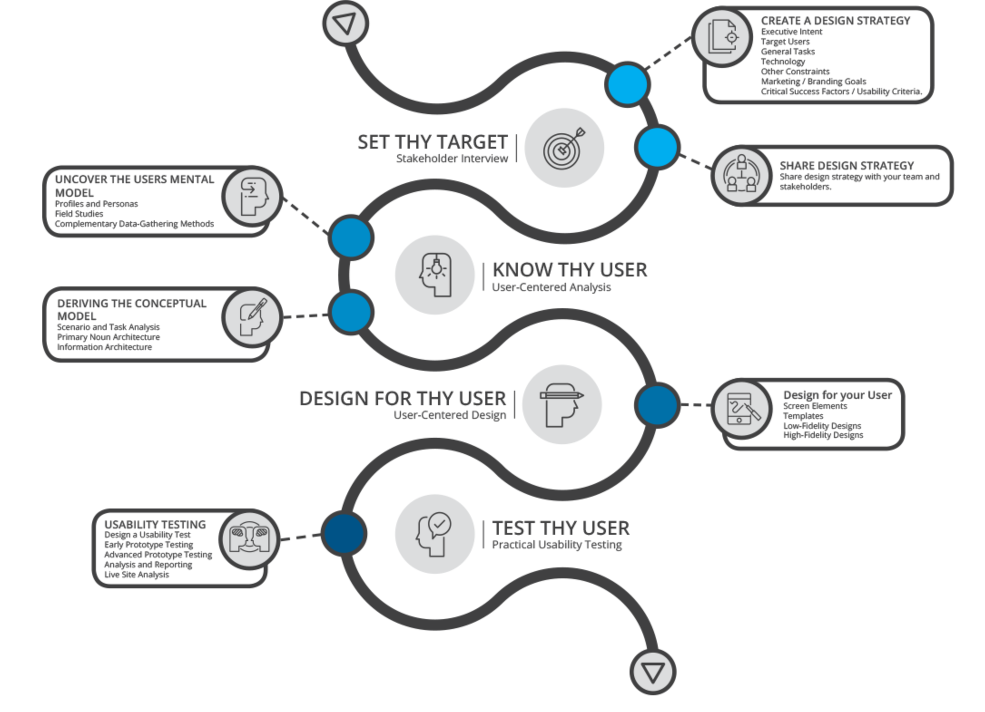

Slide 34
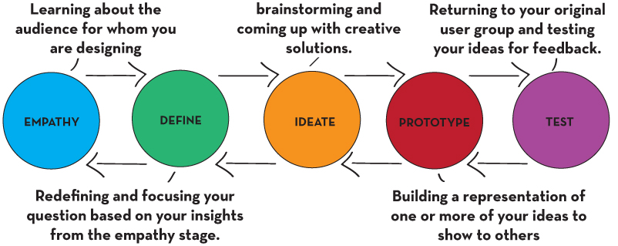
HUMAN CENTERED DESIGN APPROACH
1. Who is our Target Audience?
Any one who wants to have fun
2. What are we making and why?
A Mobile App to find and organise events through same platform
3. What will success look like?
Making the life of users easy and full of fun just by a click of button

Slide 35

TEAMWORK
Vidushi Login Signup Splash Home Search | Aashay Event details Ticket booking page Receipt/ticket Location Contact us | Mrinal Notification Feedback Settings Messages Profile | Riteeka Create event Like/History Menu Create group Group page

Slide 36


